Slide 1
The Māori & Antarctica
Mō tātou, ā, mō kā uri ā muri ake nei
“For us and our children after us” Māori (Ngāi Tahu) proverb
Contributors: Claire Jasper
Keywords: Indigenous people, Indigenous knowledge, Antarctica, exploration, Māori
Location: New Zealand, Antarctica
People: Māori, Hui-Te-Rangiora
Last updated: October 15th, 2021
Visit https://geo-context.github.io for the teacher’s companion guide to these slides.
Notes:
Slide 1 | Māori is pronounced mau·ree, a link to the pronunciation can be found here: https://upload.wikimedia.org/wikipedia/commons/e/ec/Rar-M%C4%81ori.ogg)

Slide 2
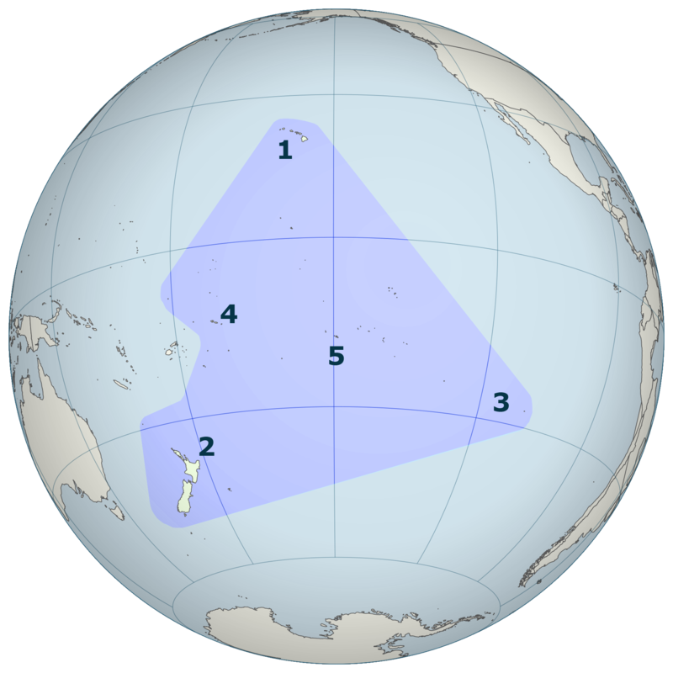
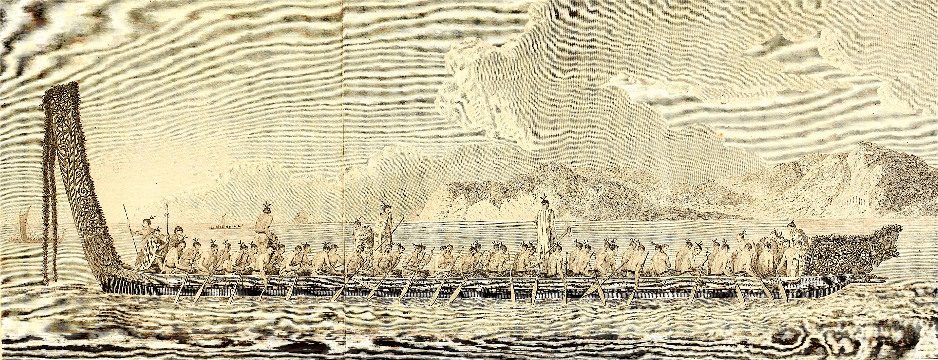
Background on the Māori
Polynesians began journeying east from New Guinea in canoes around 1500 B.C. where they soon reached the relatively close Solomon Islands.
Over time, they improved their canoes and navigational technologies, they began traveling long distances throughout the Pacific Ocean.
By 1000 A.D., Polynesians had settled on Pacific islands extending from Hawaii in the north, Easter Island in the southeast, and New Zealand in the southwest.
The Māori are the Indigenous Polynesian people who settled in New Zealand.
The Māori traveled via waka (canoes) and settled in New Zealand between 1320 and 1350 (Walter et al., 2017).
European colonization of New Zealand began in the early 19th century
Aotearoa: the Māori name for New Zealand.
Figure 1 | A depiction of the “Polynesian Triangle,” which is the geographic region of the Pacific Ocean settled by the Polynesians, from (1) Hawaii, to (2) New Zealand (Aotearoa), (3) Easter Island (Rapa Nui) , (4) Samoa, (5) Tahiti.
User:Kahuroa | Wikimedia Commons
Figure 2 | A drawing of a traditional Māori waka (canoe)
John Hawkesworth et al. | Wikimedia Commons
Notes:
Slide 2 | Polynesians began exploring east across the Pacific Ocean from New Guinea in canoes around 1500 B.C., soon reaching the Solomon Islands, only ~1000 km from New Guinea. Continuing from this initial exploration, the Polynesians improved their canoes and began traveling much further distances throughout the Pacific. Within 2500 year, (by ~ 1000 A.D.) Polynesians had settled on islands throughout the Pacific. This area of settlement is known as the “Polynesian Triangle” and spans from Hawaii in the north, Easter Island in the southeast, and New Zealand in the southwest. These islands are highlighted in the map projection in the middle of the slide with Hawaii marked as #1, #2 New Zealand (Aotearoa), and #3 Easter Island (Rapa Nui).
European colonization of New Zealand began in the early 19th century however, these islands were settled centuries before. Between 1320 and 1350 A.D, Polynesians traveled to and settled on New Zealand. These Polynesians became known as the Māori, the Indigenous Polynesian people of Aotearoa, which is now known as New Zealand. The image in the bottom right corner is a drawing of a traditional Māori canoe, or waka.

Slide 3
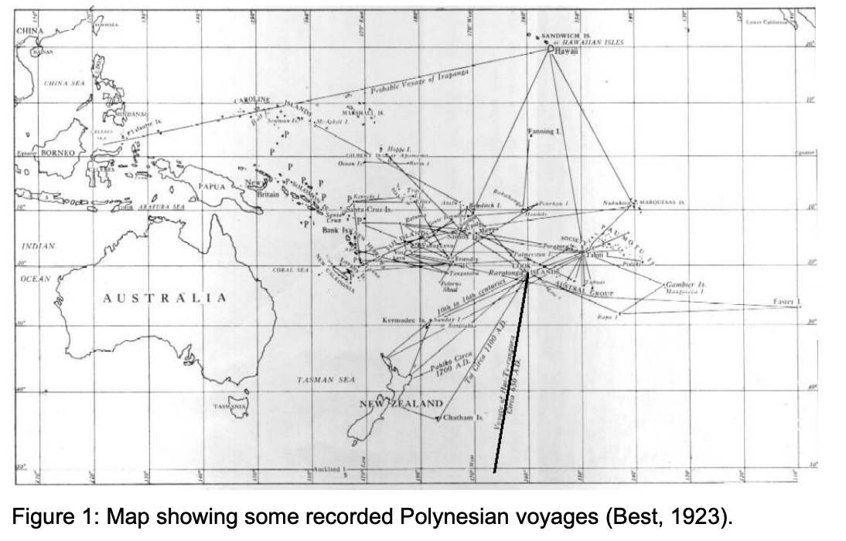
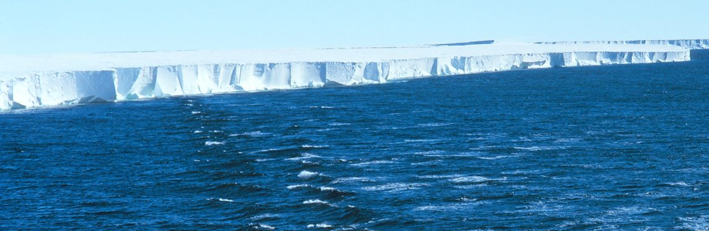
Hui Te Rangiora’s Antarctic Exploration
The oral histories of Māori tribal groups Ngati Rarua and Te Ati Awa state that the great explorer and chief, Hui Te Rangiora (also know as Ūi Te Rangiora), was the first person to discover Antarctica in ~650 A.D.
Hui Te Rangiora was given instructions to sail south of the Cook Islands to reach Aotearoa (New Zealand) on the vessel Te Iwi-o-Atea.
He and his crew missed Aotearoa and continued to sail south and reported that they saw “a white land that was floating,” likely the ice shelves surrounding Antarctica
Cook Islands
Hui Te Rangiora’s journey to Antarctica
^ Figure 3 | Map showing recorded Polynesian voyages in the Pacific and Southern Oceans. The bolded ship track is Hui-Te-Rangiora’s route to the Southern Ocean in ~650 A.D., where he discovered Antarctica (Best, 1923)
E. Best| Dominion Museum
< Figure 4 | Image of Antarctica (“a white land that was floating”), specifically a panorama of the Ross Ice Shelf
NOAA Corp Collection | Wikimedia Commons
Notes:
Slide 3 | According to the oral histories of the Māori tribal groups Ngati Rarua and Te Ati Awa a great Māori explorer and chief, Hui Te Rangiora sailed into Antarctic waters and caught sight of land in 650 A.D.
Hui Te Rangiora was sent on an expedition south of the Cook Islands (highlighted on the map to the right) to reach Aotearoa (New Zealand). He and his crew traveled south from the Cook Islands, however, they missed Aotearoa to the west and continued south. The route can be seen as the bolded track highlighted in Figure 3. As their journey continued south, they spotted “a white land that was floating.” Hui Te Rangiora and his crew likely had spotted the ice shelves surrounding Antarctica, similar to the photograph of the Ross Ice Shelf in the bottom left cornere of the slide.

Slide 4
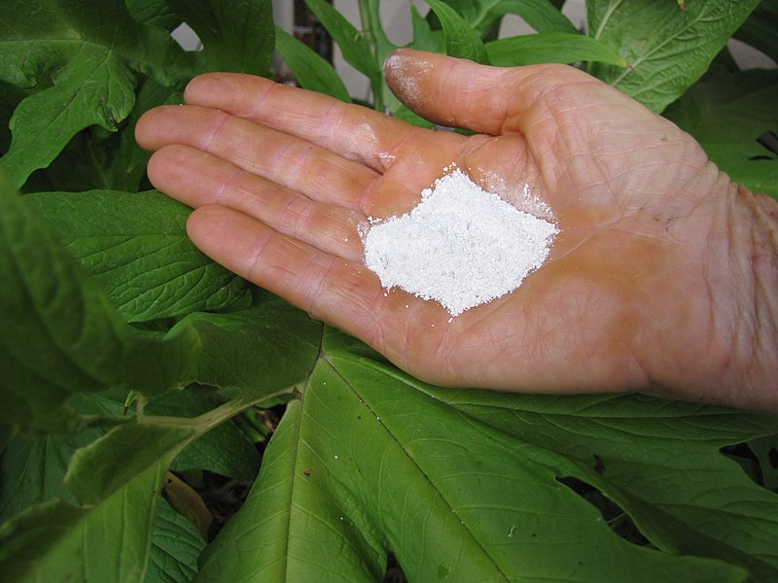
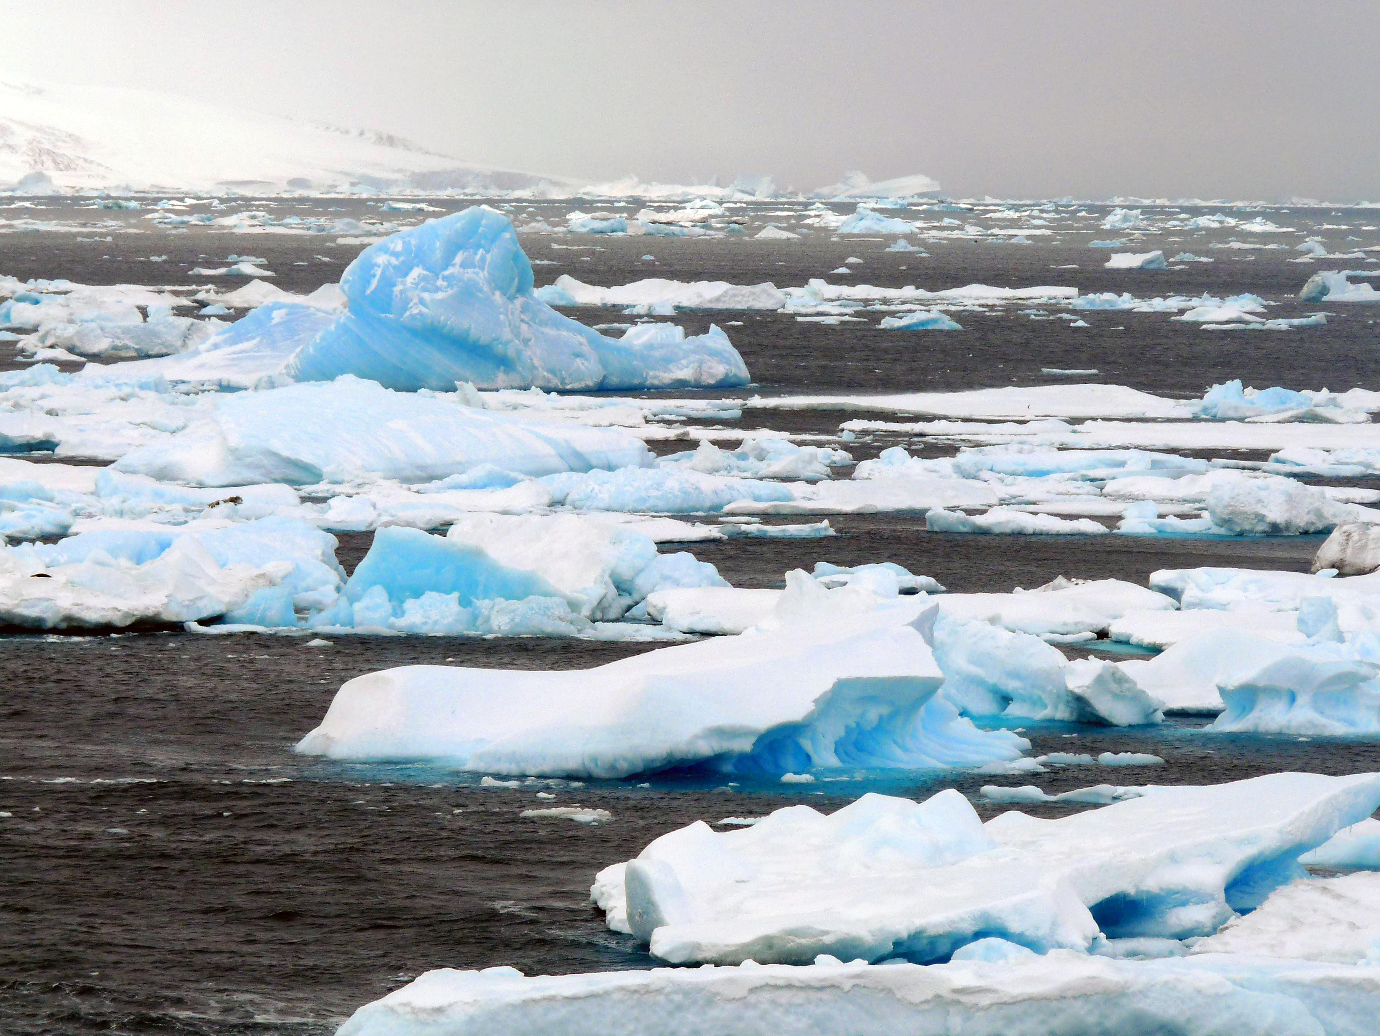
Māori Observations of Antarctica
Further evidence of the Māori exploring deep into the Southern Ocean comes from their description of the water as Te tai-uka-a-pia or “sea foaming like arrowroot.” “Pia” refers to arrowroot, which looks like snow when it is scraped and powdered (Figure 5).
Below is an account of the sub-Antarctic flora, fauna and physical geography from the history of Te Aru-tanga-nuku (a Māori voyager) from Smith (1899, p. 10)
Figure 5 | An image of what “pia” (Polynesian arrowroot) looks like when it is powdered. This is what the ice floes in Antarctica were compared to.
Forest and Kim Starr| Wikimedia Commons
“... the rocks that grow out of the sea, in the space beyond Rapa; the monstrous seas; the female that dwells in those mountainous waves, whose tresses wave about in the water and on the surface of the sea; and the frozen sea of pia, with the deceitful animal of the sea who dives to great depths – a foggy, misty, and dark place not seen by the sun. Other things are like rocks, whose summits pierce the skies, they are completely bare and without vegetation on them.”
Figure 6 | An Antarctic ice floe which was described as “the frozen sea of pia”
Michael Clarke| Wikimedia Commons
Notes:
Slide 4 | There are documented observations of the Māori exploration of the Southern Ocean and Antarctica. They described the ocean water as Te tai-uka-a-pia, or “sea foaming like arrowroot.” The term “pia” refers to arrowroot, a root vegetable common in the Polynesian diet. When pia is scraped and powdered, it looks like snow as seen in the image at the top left of the slide (Figure 5). The Māori explorers were likely describing ice floes within the Antarctic waters, similar to that seen pictured in the bottom left of the slide (Figure 6).
The quote within the green box is an account of the sub-Antarctic flora, fauna, and physical geography from a Māori voyager, Te Aru-tanga-nuku, and expands upon the Māori observations of Antarctica. Note that they highlight the “frozen sea of pia,” likely indicating the masses of ice floating. They also observe “deceitful animal of the sea who dives to great depths,” which were likely marine mammals and penguins. They also go on to describe “Other things are like rocks, whose summits pierce the skies, they are completely bare and without vegetation on them,” likely observing the mountainous terrain of the Antarctic continent.

Slide 5
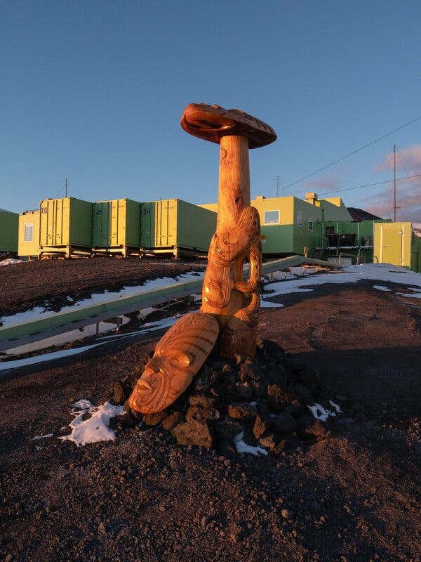
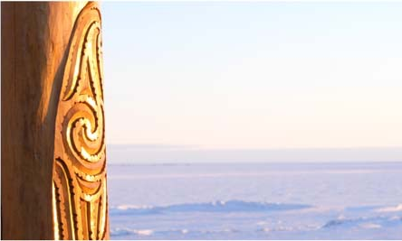
Māori Presence in Antarctica Today
In 2013, a Ngāi Tahu carver, Fayne Robinson, carved a post named Te Kaiwhakatere o te Raki which translates to “Navigator of the Heavens”
This post sits at New Zealand’s Antarctic research station, Scott Base
The head looks skyward to symbolize the importance of celestial navigation
As Māori leadership in Antarctic research becomes more visible and tribal researchers begin to share their narratives, further evidence of Māori exploration will likely come to light
“The pouwhenua personifies exploration, adventure and discovery, which are defining characteristics of all people, past and present, who journey to Antarctica. The head of the Te Kaiwhakatere o Te Raki looks straight up to the sky as a symbol of celestial navigation. It is decorated with stars, waves, water and animals depicting nature and representing the importance of the environment.” (Te Pānui Rūnaka, 2013)
Figure 7 ^ | Te Kaiwhakatere o te Raki looking up to the sky, Scott Base behind.
Figure 8 >| The view of Te Kaiwhakatere o te Raki looking outward across the Ross Ice Shelf
Both images sourced from Wehi et al. 2021
Notes:
Slide 5 | While Māori are an integral piece of Antarctica’s history of exploration in the past, they continue to be a vital presence in Antarctica today. This slide shows photographs of a Māori carving located in Antarctica. In 2013, a Māori carver (from the Māori “iwi” or nation, Ngāi Tahu) Fayne Robinson carved a post named Te Kaiwhakatere o te Taki, or “Navigator of the Heavens.” This Māori post sits at Scott Base, New Zealand’s Antarctic research station situated adjacent to the Ross Ice Shelf. The head of the carving (see in the middle photograph, Figure 8) looks directly skyward to symbolize the importance of celestial navigation to the Māori. The post is also decorated with stars, waves, water and animals to celebrate the Antarctic ecosystem and the importance of the environment. Figure 8 (middle) shows the full carving in the foreground with Scott Base in the background while Figure 9 (bottom right) pictures the view looking outward from the carving across the vast Ross Ice Shelf.

Slide 6
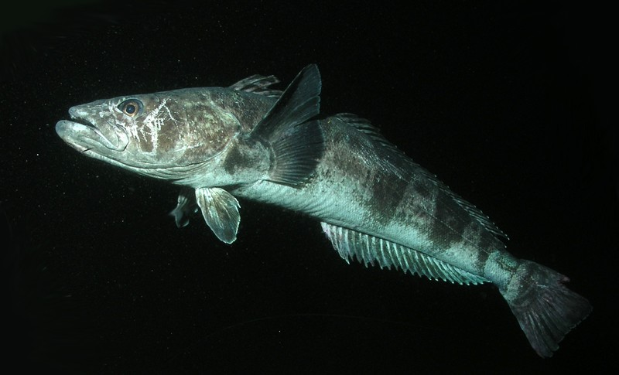
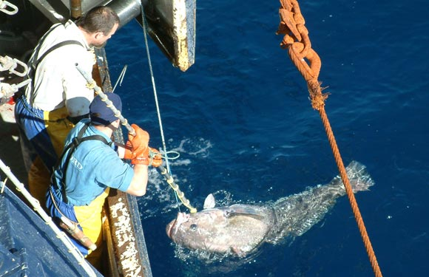
Māori Today: Improving Frameworks of Antarctic Fisheries
Toothfish are a top predator in the Antarctic and the most prosperous fishery is in the Ross Sea
In 2010, there was an assessment of the long-term sustainability of the Ross Sea toothfish fishery from an Indigenous Ngāi Tahu (A Māori iwi or “nation”) perspective. This assessment highlighted how the culturally centered “best practices” can lead to sustainable outcome for the fishery:
Future of Increasing Inclusion: To date, there are very limited mechanisms for the inclusion of environmental perspectives of Indigenous people in the Convention on the Conservation of Antarctic Marine Living Resources (CCAMLR). Inclusion of Indigenous best practices would likely be mutually beneficial for the sustainable management of the Southern Ocean.
“Key customary practices include imposing catch and size limits, use of seasonal and spatial closures, protection of important habitats for fisheries management, protection of associated and dependent species, and compliance and enforcement,” (Scott, 2010)
Figure 9 | Top: An Antarctic toothfish in the water, Bottom: two fishermen pulling in an Antarctic toothfish on a longline
Top: Rob Robbins | Encyclopedia Westarctica
Bottom: John Bennett | Encyclopedia Westarctica
Notes:
Slide 6 | In addition to the Māori presence in Antarctic exploration and research, Māori are also involved in the commercial use and preservation of Antarctic fisheries, including the Toothfish fishery. Toothfish (pictured in the images to the right) are a top predator in Antarctic waters and are the most prosperous fishery in the Ross Sea. In 2010, there was an assessment of the long-term sustainability of the Ross Sea toothfish fishery from an Indigenous Ngāi Tahu (A Māori iwi or “nation”) perspective. Some of the main priorities are “imposing catch size and limits,” “use of seasonal and spatial closures,” protections of habitats, protections of associated and dependent species, compliance, and enforcement. These Māori best practices highlighted how culture-centered “best practices” can lead to the sustainable long term outcome for the fishery.
There are currently very limited mechanisms for the inclusion of environmental perspectives of Indigenous people in the Convention on the Conservation of Antarctic Marine Living Resources (CCAMLR). Inclusion of Indigenous best practices would likely be mutually beneficial for the sustainable management of Southern Ocean fisheries.

Slide 7
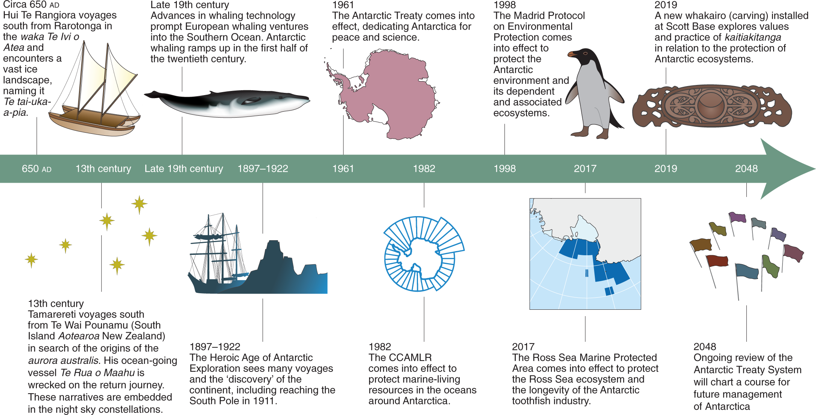
Extra: Timeline of Major Events in Antarctica
Figure 10 | Timeline from Wehi et al. (2021) which provides an overview of human interactions and exploration in Antarctica beginning with Hui-Te-Rangiora’s voyage in 650 A.D.
Notes:
Slide 7 | This slide provides a broader context for Antarctica’s human history over time and moving into the future. This timeline comes from a paper by Wehi et al. (2021) and highlights major events such as Hui Te Rangiora’s voyage in ~650 A.D. to The Antarctic Treaty in 1961 to the planned review and revision of the Antarctic Treaty System in 2048.

